Slide 1

Costing implementation strategies using Cost-IS
Thomasina Donovan
PhD student
Australian Centre for Health Services Innovation (AusHSI)
Queensland University of Technology (QUT)
Acknowledgement of Traditional Owners
QUT acknowledges the Turrbal and Yugara, as the First Nations owners of the lands where QUT now stands. We pay respects to their Elders, lores, customs and creation spirits. We recognise that these lands have always been places of teaching, research and learning. QUT acknowledges the important role Aboriginal and Torres Strait Islander people play within the QUT community.

Slide 2
Introduction
Cost-IS
Development of Cost-IS
Activity
OVERVIEW

Slide 3
Introduction
Cost-IS
Development
Activity
Implementation costing
Importance:
Appropriate funding → implementation success
Capture full extent of costs → policy making

Slide 4

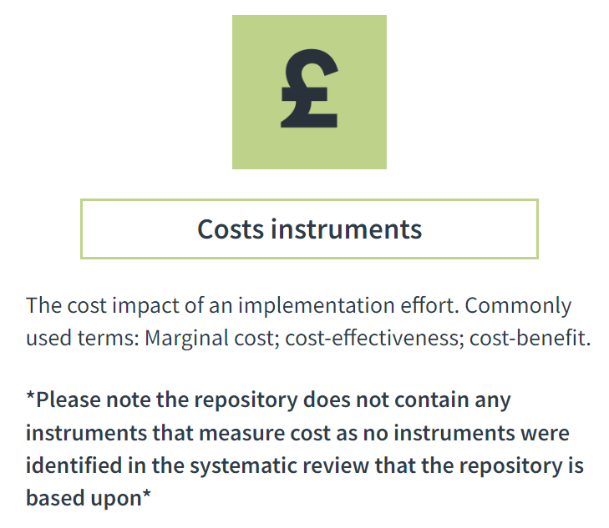
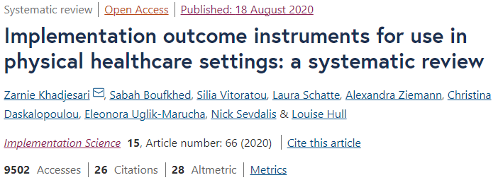
Introduction
Cost-IS
Development
Activity
Implementation costing

Slide 5


Introduction
Cost-IS
Development
Activity
Implementation costing tool

Slide 6
Introduction
Cost-IS
Development
Activity
Implications
increased reporting of implementation cost estimates in the literature
Costing implementation strategies (Cost-IS)
appropriate resourcing for implementation strategies → ↑ implementation success
economic evaluations of health care innovations that account for the full extent of costs → reliable information for decision makers
Notes:
- methods for quantifying the key resources required for implementation efforts of healthcare interventions were investigated
- Developed a new data collection tool (Cost-IS) to assist in the estimation of costs associated with implementation strategies.
- Cost-IS was shown to be flexible and could be tailored to meet the requirements of a range of implementation projects.
- Reliable implementation cost estimations produced from this standardised tool will inform appropriate resourcing for implementation strategies resulting in a greater likelihood of implementation success.
- As well as providing decision makers with reliable information from economic evaluations of health care innovations that account for the full extent of costs.
- It is anticipated that the transdisciplinary nature of Cost-IS will contribute to an expanded knowledge of implementation costs through improved collaboration between implementation scientists and health economists.

Slide 7
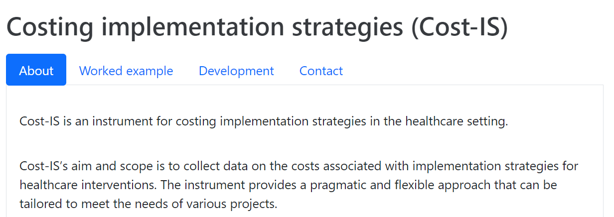
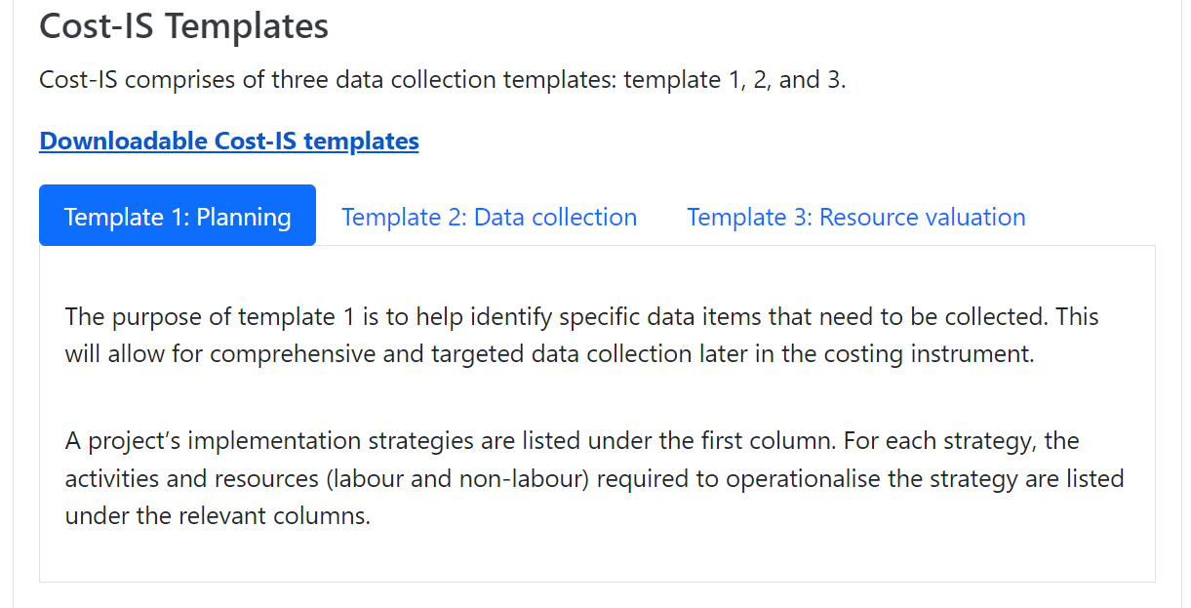

Introduction
Cost-IS
Development
Activity
Cost-IS
Notes:
Key contributions are similar to findings of Study 2 but will show how it’s been incorporated into Cost-IS
Fosters collaboration because it addresses challenge of misaligned language between the disciplines
Limitation: requirement of prior knowledge a perceived
Leverages ERIC framework
implementation strategies were the most common and easiest to identify
implementation strategies are generic
familiar framework
Limitation: not all implementation activities and associated resources can be mapped to ERIC
alleviates burden
utilise already collected data
Limitation: precision and accuracy trade-offs
flexible and structured alternative may be used as a standardisation approach

Slide 8
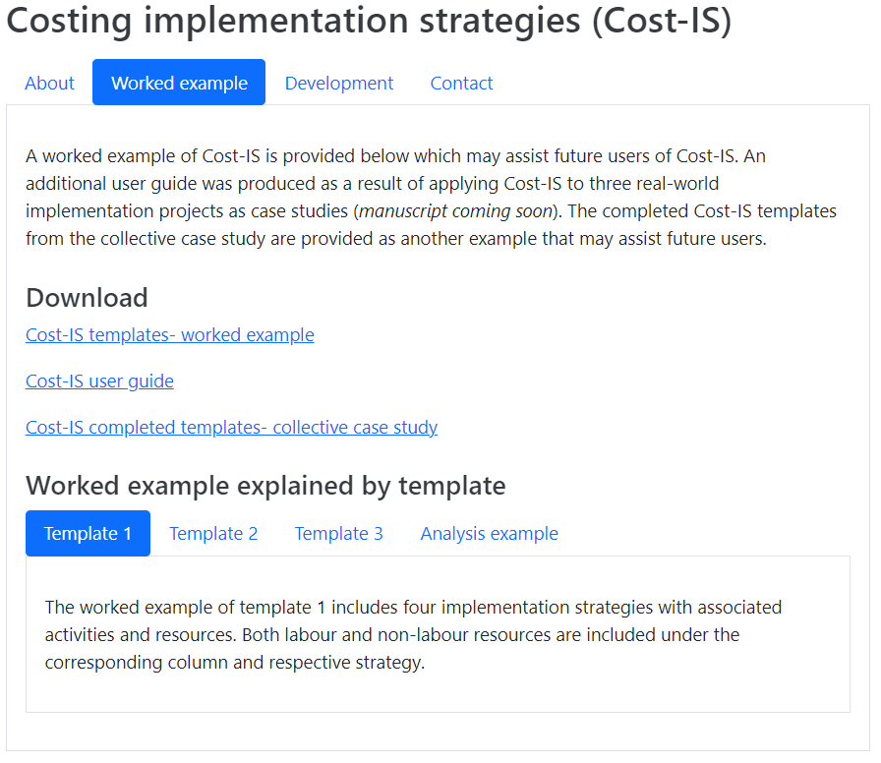
Introduction
Cost-IS
Development
Activity
Cost-IS
Notes:
Key contributions are similar to findings of Study 2 but will show how it’s been incorporated into Cost-IS
Fosters collaboration because it addresses challenge of misaligned language between the disciplines
Limitation: requirement of prior knowledge a perceived
Leverages ERIC framework
implementation strategies were the most common and easiest to identify
implementation strategies are generic
familiar framework
Limitation: not all implementation activities and associated resources can be mapped to ERIC
alleviates burden
utilise already collected data
Limitation: precision and accuracy trade-offs
flexible and structured alternative may be used as a standardisation approach

Slide 9
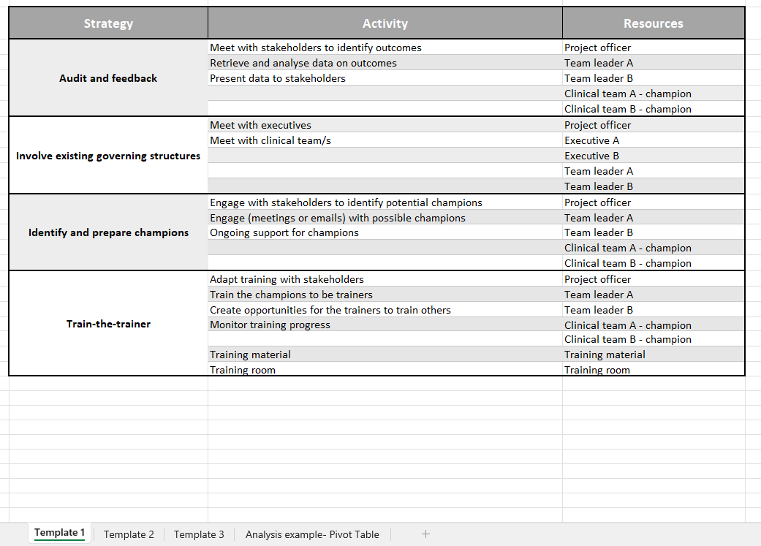
Introduction
Cost-IS
Development
Activity
Template 1: Planning
Cost-IS
Notes:
Key contributions are similar to findings of Study 2 but will show how it’s been incorporated into Cost-IS
Fosters collaboration because it addresses challenge of misaligned language between the disciplines
Limitation: requirement of prior knowledge a perceived
Leverages ERIC framework
implementation strategies were the most common and easiest to identify
implementation strategies are generic
familiar framework
Limitation: not all implementation activities and associated resources can be mapped to ERIC
alleviates burden
utilise already collected data
Limitation: precision and accuracy trade-offs
flexible and structured alternative may be used as a standardisation approach

Slide 10
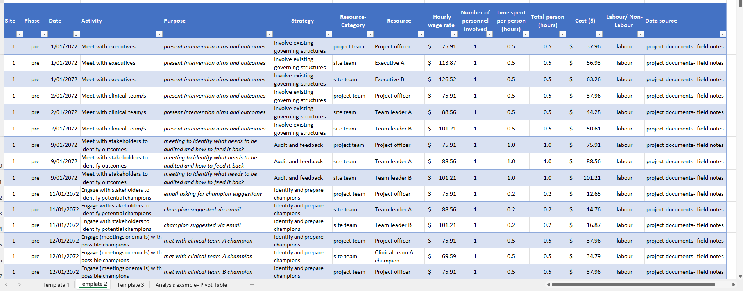
Introduction
Cost-IS
Development
Activity
Template 2: Capture
Cost-IS
Notes:
Key contributions are similar to findings of Study 2 but will show how it’s been incorporated into Cost-IS
Fosters collaboration because it addresses challenge of misaligned language between the disciplines
Limitation: requirement of prior knowledge a perceived
Leverages ERIC framework
implementation strategies were the most common and easiest to identify
implementation strategies are generic
familiar framework
Limitation: not all implementation activities and associated resources can be mapped to ERIC
alleviates burden
utilise already collected data
Limitation: precision and accuracy trade-offs
flexible and structured alternative may be used as a standardisation approach

Slide 11
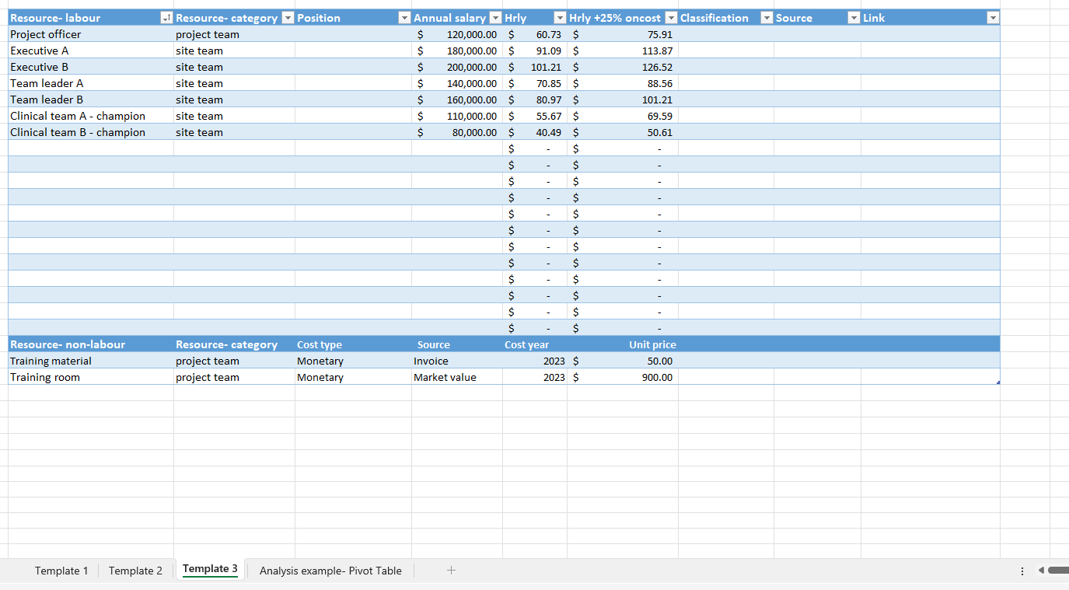
Introduction
Cost-IS
Development
Activity
Template 3: Valuation
Cost-IS
Notes:
Key contributions are similar to findings of Study 2 but will show how it’s been incorporated into Cost-IS
Fosters collaboration because it addresses challenge of misaligned language between the disciplines
Limitation: requirement of prior knowledge a perceived
Leverages ERIC framework
implementation strategies were the most common and easiest to identify
implementation strategies are generic
familiar framework
Limitation: not all implementation activities and associated resources can be mapped to ERIC
alleviates burden
utilise already collected data
Limitation: precision and accuracy trade-offs
flexible and structured alternative may be used as a standardisation approach

Slide 12
Introduction
Cost-IS
Development
Activity
Implementation strategy cost estimates
Notes:
Cost-IS facilitates displaying of implementation cost findings in various ways including by implementation strategies or by implementation resource type
Challenges during this process include:
separating implementation from intervention costs and research-related costs
dependence on existing documentation for case study implementation contributed to this challenge as well as other challenges including key data inputs being unavailable, and aggregate documentation of some resources.

Slide 13
Introduction
Cost-IS
Development
Activity
Study 1:
Systematic review
Study 2:
Interviews
identify current practice/ methodology
understand stakeholders wants and needs
Cost-IS
confirm stakeholders’ wants and needs are addressed
preliminarily validation of tool
Study 3:
Modified e-Delphi
Study 4:
Collective case study
Notes:
Review literature on implementation cost estimates and the methods that have been used to measure and value these costs.
Investigate experiences and perceptions for capturing the costs associated with implementation efforts in practice.
Develop a data collection instrument for identifying, measuring and valuing the key costs of implementation efforts.
Understand conditions for the application of the data collection instrument in practice.

Slide 14
Introduction
Cost-IS
Development
Activity
Study 1:
Systematic review
Study 2:
Interviews
identify current practice/ methodology
understand stakeholders wants and needs
Cost-IS
No established guidance to cost implementation
low quantity of reporting on implementation costs
unclear reporting of implementation costs
unclear methods used to measure and value implementation costs
confirm stakeholders’ wants and needs are addressed
preliminarily validation of tool
Study 3:
Modified e-Delphi
Study 4:
Collective case study
Notes:
N=9 compared to n=100
Implementation strategies not often clearly reported
Mapped implementation (like) activities to ERIC
Then determined if the implementation activity was costed
Humans (n=9 /9)
n= 2 activity diaries & interviews
n=7 ?
Things (n=3 /9)
n=1 estimated over time horizon
n= 2 ?
Space (n=1 /9)
n= 1 rental opportunity cost

Slide 15
Introduction
Cost-IS
Development
Activity
Study 1:
Systematic review
Study 2:
Interviews
Finding
identify current practice/ methodology
Recommendation
understand stakeholders wants and needs
Cost
-
IS feature
Challenging to identify
implementation
A set of discrete
understand stakeholders wants and needs
Leverages ERIC
cost data
Cost-IS
cost categories
Burden
of collecting the necessary data
Reduce burden of
Utilise already
data collection
collected data
Facilitated by multidisciplinary
Increase
Transdisciplinary
collaboration
collaboration
confirm stakeholders’ wants and needs are addressed
preliminarily validation of tool
Staff time tracking was the most frequent
Standardised tool
Pragmatic and
Study 3:
Modified e-Delphi
Study 4:
Collective case study
method, but
variation
was present
flexible
“If we're listening to what people want on the ground, they want really practical tools...” [HE/DH]
Notes:
A set of discrete cost categories should be developed prior to the collection of implementation cost data. Categories may be defined based on relevant implementation strategies, project activities or project phases.
Efforts should be made to reduce the burden of implementation cost data collection. This may be achieved through use of existing databases or leveraging data that has been collected for other purposes.
Standardisation of implementation cost data collection and estimation is needed. This may be facilitated through tools that are pragmatic, flexible and feasible to use in practice.
Increased collaboration between implementation scientists and health economists is required to ensure a common understanding.

Slide 16

Introduction
Cost-IS
Development
Activity
Q: comprehensively collect data on implementation costs (i.e., key data can be captured)
Study 1:
Systematic review
Study 2:
Interviews
Round 1:
Feedback → refinement of scope
“aims to cost implementation strategies”
Round 2:
Assume users have implementation science knowledge
Use beyond digital health setting
identify current practice/ methodology
understand stakeholders wants and needs
Q: useful aid for identifying implementation costs (i.e., has value)
Cost-IS
Q: flexible for use across a range of initiatives i.e., functional in design)
Q: practical (i.e., functional in design)
confirm stakeholders’ wants and needs are addressed
preliminarily validation of tool
Study 3:
Modified e-Delphi
Study 4:
Collective case study
Notes:
Pilot questionnaire: Cognitive pretesting of the questionnaires using a think aloud method was conducted
The refined Planning Template (Table 1) remains useful
The refined Labour Data Collection Template (Table 2) remains useful
The refined Non-Labour Data Collection Template (Table 3) remains useful
The refined costing instrument could adequately capture implementation costs
The automated summary tables are a useful addition to the costing instrument
Modified Delphi - gather expert opinion and develop a consensus
Iterative rounds until consensus is reached
Consensus= unanimous, majority, or at the discretion of the researcher
3 rounds have been completed to prevent sample fatigue
The research team considered that the mixed responses to these instrument supporting materials was likely due to ambiguity in the scope of the instrument.
IS knowledge- In Round 2, we asked the participants if it is appropriate to assume users of the costing instrument will have some level of prior implementation science knowledge; this statement did not reach consensus.
DH- most participants recognised it was plausible the instrument could be generic. The research team concluded that subsequent piloting would be required to confirm or refute the extent to which the instrument was generalisable beyond digital health.
Digital formats- Participants were satisfied with the Microsoft Excel version and did not indicate interest in any additional digital formats suggested, including REDCap, Microsoft Word, or PDF

Slide 17

Introduction
Cost-IS
Development
Activity
Study 1:
Systematic review
Study 2:
Interviews
Cost-IS is a flexible instrument that can be tailored to meet the requirements of a range of implementation projects.
Length: 1-4 year projects, between 2019 and 2023
Location: Qld, Australia
Sites:
11x Residential aged care homes
3x hospitals
3x wards in a hospital
Digital health: n=1
identify current practice/ methodology
understand stakeholders wants and needs
Cost-IS
n= 3
confirm stakeholders’ wants and needs are addressed
preliminarily validation of tool
Study 3:
Modified e-Delphi
Study 4:
Collective case study
Notes:
Between three real-world implementation case studies
Aim 4.c) understand how Cost-IS could be used in practice by observing its feasibility, generalisability, and limitations
Challenges during this process include:
separating implementation from intervention costs and research-related costs
dependence on existing documentation for case study implementation contributed to this challenge as well as other challenges including key data inputs being unavailable, and aggregate documentation of some resources.

Slide 18

Introduction
Cost-IS
Development
Activity
Study 1:
Systematic review
Study 2:
Interviews
identify current practice/ methodology
understand stakeholders wants and needs
Cost-IS
confirm stakeholders’ wants and needs are addressed
preliminarily validation of tool
Study 3:
Modified e-Delphi
Study 4:
Collective case study
Notes:
Implementation cost knowledge has rapidly increased as seen with the recent release of a costing guidebook for implementation scientists. As the number of quality studies increases, the ability to estimate implementation cost is likely to become more accurate
Prospective study designs may allow for more comprehensive in future studies.
The extent to which the findings (and Cost-IS) generalises beyond academia and dissimilar contexts internationally is uncertain.
Cost-IS was designed to estimate the costs of implementation strategies, which limits the scope of overall implementation costing to largely tangible cost items. Intangible costs including soft skills, personal reflection time, existing relationships, level of authority, and mental load are more challenging to account for, but have been highlighted as contributing to implementation
De-implementation is its own process, separate to implementation, with relevant behaviour change strategies incurring additional resource use and associated costs. Cost is often used as a justification for de-implementation but, similar to implementation, little research exists on the costs associated with de-implementation strategies. This may be an important consideration in the digital health setting because of the relatively short life cycle of technology, between three and five years. Depending on the nature of hardware and software assets, the costs of de-implementation of technology may need to be considered within the context of economic evaluation.

Slide 19
Introduction
Cost-IS
Development
Activity
Limitations
Retrospective approach taken
Majority of participants were working in academic contexts and based in Australia
Not all resources are captured
Intangible costs
De-implementation
Study 1:
Systematic review
Study 2:
Interviews
identify current practice/ methodology
understand stakeholders wants and needs
Cost-IS
confirm stakeholders’ wants and needs are addressed
preliminarily validation of tool
Study 3:
Modified e-Delphi
Study 4:
Collective case study
Notes:
Implementation cost knowledge has rapidly increased as seen with the recent release of a costing guidebook for implementation scientists. As the number of quality studies increases, the ability to estimate implementation cost is likely to become more accurate
Prospective study designs may allow for more comprehensive in future studies.
The extent to which the findings (and Cost-IS) generalises beyond academia and dissimilar contexts internationally is uncertain.
Cost-IS was designed to estimate the costs of implementation strategies, which limits the scope of overall implementation costing to largely tangible cost items. Intangible costs including soft skills, personal reflection time, existing relationships, level of authority, and mental load are more challenging to account for, but have been highlighted as contributing to implementation
De-implementation is its own process, separate to implementation, with relevant behaviour change strategies incurring additional resource use and associated costs. Cost is often used as a justification for de-implementation but, similar to implementation, little research exists on the costs associated with de-implementation strategies. This may be an important consideration in the digital health setting because of the relatively short life cycle of technology, between three and five years. Depending on the nature of hardware and software assets, the costs of de-implementation of technology may need to be considered within the context of economic evaluation.

Slide 20
Introduction
Cost-IS
Development
Activity
Activity
ERIC Clusters | DALABA 2014
Engage Consumers
Use evaluative & iterative strategies
Change infrastructure
Adapt & tailor to the context
Develop stakeholder interrelationships
Utilize financial strategies
Support clinicians
Train & educate stakeholders
Provide interactive assistance
Identify and categorise implementation costs from a published paper

Slide 21
Introduction
Cost-IS
Development
Activity
Activity
ERIC Clusters | DALABA 2014
Engage Consumers
Use evaluative & iterative strategies
Change infrastructure
Adapt & tailor to the context
Develop stakeholder interrelationships | Use advisory boards and workgroups: stakeholder meeting, in which the directors of health services, district public health nurses, midwives and other key stakeholders participated
Utilize financial strategies
Support clinicians
Train & educate stakeholders
Provide interactive assistance
Identify and categorise implementation costs from a published paper

Slide 22
Introduction
Cost-IS
Development
Activity
Strategy
Activity
Resources
Use advisory boards and
stakeholder meeting, in which the directors of health services, district
directors of health services
workgroups
public health nurses, midwives and other key stakeholders participated
district public health nurses
midwives
other key stakeholders
meeting room?
Template 1: Planning
Cost-IS

Slide 23
Introduction
Cost-IS
Development
Activity
Hourly
Number of
Time
Total
Labour/
Resource
Site
Phase
Date
Activity
Purpose
Strategy
-
Resource
wage
personnel
spent per
person
Cost ($)
Non
Data
Category
person
-
source
rate
involved
(hours)
(hours)
Labour
stakeholder meeting,
in which
During the meeting, the
the directors of health services,
computer
-
assisted CDSS concept
Use advisory
directors of
?
?
?
district public health nurses,
was discussed and approval and
boards and
health
midwives and other key
support by the stakeholders were
workgroups
services
stakeholders participated
established
district public
health nurses
midwives
other key
stakeholders
Template 2: Capture
Cost-IS

Slide 24
Introduction
Cost-IS
Development
Activity
Hourly
Number of
Time
Total
Labour/
Resource
Site
Phase
Date
Activity
Purpose
Strategy
-
Resource
wage
personnel
spent per
person
Cost ($)
Non
Data
Category
person
-
source
rate
involved
(hours)
(hours)
Labour
stakeholder meeting,
in which
During the meeting, the
the directors of health services,
computer
-
assisted CDSS concept
Use advisory
directors of
?
?
?
district public health nurses,
was discussed and approval and
boards and
health
midwives and other key
support by the stakeholders were
workgroups
services
stakeholders participated
established
stakeholder meeting,
in which
During the meeting, the
the directors of health services,
computer
-
assisted CDSS concept
Use advisory
district public
?
?
?
district public health nurses,
was discussed and approval and
boards and
health nurses
midwives and other key
support by the stakeholders were
workgroups
stakeholders participated
established
stakeholder meeting
, in which
During the meeting, the
the directors of health services,
computer
-
assisted CDSS concept
Use advisory
?
?
?
district public health nurses,
was discussed and approval and
boards and
midwives
midwives and other key
support by the stakeholders were
workgroups
stakeholders participated
established
stakeholder meeting,
in which
During the meeting, the
the directors of health services,
computer
-
assisted CDSS concept
Use advisory
other key
?
?
?
district public health nurses,
was discussed and approval and
boards and
stakeholders
midwives and other key
support by the stakeholders were
workgroups
stakeholders participated
established
Template 2: Capture
Cost-IS

Slide 25
Introduction
Cost-IS
Development
Activity
Resource
-
labour
Resource
-
Position
Annual
Hrly
Hrly +25% oncost
Classification
Source
Link
category
salary
directors of health
services
site team
$
140,000
$ 70.85
$ 88.56
district public
health nurses
site team
$ 120,000
$ 60.73
$ 75.91
midwives
site team
$ 115,000
$ 58.20
$ 72.75
other key
stakeholders
site team
$ 150,000
$ 75.91
$ 94.89
$
-
$
-
$
-
$
-
Resource
-
non
-
Resource
-
Cost type
Source
Cost year
Unit price
labour
category
meeting room?
Template 3: Valuation
Cost-IS

Slide 26
Introduction
Cost-IS
Development
Activity
Hourly
Number of
Time
Total
Labour/
Resource
Site
Phase
Date
Activity
Purpose
Strategy
-
Resource
wage
personnel
spent per
person
Cost ($)
Non
Data
Category
person
-
source
rate
involved
(hours)
(hours)
Labour
stakeholder meeting,
in which
During the meeting, the
the directors of health services,
computer
-
assisted CDSS concept
Use advisory
directors of
$
$
published
?
?
?
district public health nurses,
was discussed and approval and
boards and
site team
health
88.56
2
1.0
2.0
177.13
labour
paper
midwives and other key
support by the stakeholders were
workgroups
services
stakeholders participated
established
stakeholder meeting,
in which
During the meeting, the
the directors of health services,
computer
-
assisted CDSS concept
Use advisory
district public
$
$
published
?
?
?
district public health nurses,
was discussed and approval and
boards and
site team
health nurses
75.91
3
1.0
3.0
227.73
labour
paper
midwives and other key
support by the stakeholders were
workgroups
stakeholders participated
established
stakeholder meeting
, in which
During the meeting, the
the directors of health services,
computer
-
assisted CDSS concept
Use advisory
$
$
published
?
?
?
district public health nurses,
was discussed and approval and
boards and
site team
midwives
72.75
4
1.0
4.0
290.99
labour
paper
midwives and other key
support by the stakeholders were
workgroups
stakeholders participated
established
stakeholder meeting,
in which
During the meeting, the
the directors of health services,
computer
-
assisted CDSS concept
Use advisory
other key
$
$
published
?
?
?
district public health nurses,
was discussed and approval and
boards and
site team
stakeholders
94.89
5
1.0
5.0
474.44
labour
paper
midwives and other key
support by the stakeholders were
workgroups
stakeholders participated
established
Template 2: Capture
Cost-IS

Slide 27
Introduction
Cost-IS
Development
Activity
Analysis example
Cost-IS

Slide 28
Introduction
Cost-IS
Development
Activity
Strategy
Activity
Resources
Use advisory boards and
stakeholder meeting, in which the directors of health services, district
directors of health services
workgroups
public health nurses, midwives and other key stakeholders participated
district public health nurses
midwives
other key stakeholders
meeting room?
Template 1: Planning
Cost-IS

Slide 29

Introduction
Cost-IS
Development
Activity
Activity
Identify and categorise implementation costs from a published paper.
Activity sheet and published paper are printed on the table or access through QR code, navigating website to ‘ISRW’ tab
Read through the published paper
Answer the questions
Discuss answers
Cost-IS

Slide 30
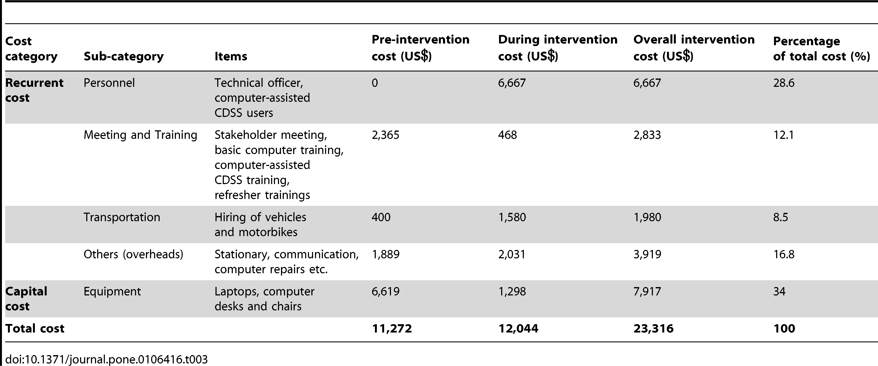
Introduction
Cost-IS
Development
Activity
Activity
Table 3. Financial costs distribution of computer-assisted CDSS implementation (US$).

Slide 31
Introduction
Cost-IS
Development
Activity
Activity
ERIC Clusters | DALABA 2014
Engage Consumers
Use evaluative & iterative strategies
Change infrastructure
Adapt & tailor to the context
Develop stakeholder interrelationships
Utilize financial strategies
Support clinicians
Train & educate stakeholders
Provide interactive assistance
Categorising implementation costs using ERIC clusters

Slide 32
Introduction
Cost-IS
Development
Activity
Activity
Break to complete the activity
Return in 20mins to discuss
Cost-IS
Questions:
Identify implementation costs from Table 3.
Categorise implementation costs into the ERIC framework categories.
Are there any additional implementation costs described in the paper?

Slide 33
Activity answers
Table 3. Financial costs distribution of computer-assisted CDSS implementation (US$).

Slide 34
Activity answers
ERIC Clusters | DALABA 2014
Engage Consumers
Use evaluative & iterative strategies
Change infrastructure
Adapt & tailor to the context
Develop stakeholder interrelationships | Use advisory boards and workgroups: stakeholder meeting, in which the directors of health services, district public health nurses, midwives and other key stakeholders participated
Utilize financial strategies
Support clinicians
Train & educate stakeholders | Conduct educational outreach visits AND/OR Provide ongoing consultation: technical officer visited the computer-assisted CDSS users fortnightly to monitor and supervise them. Conduct ongoing training: technical officer trains a new user to continue the use of the computer-assisted CDSS Conduct ongoing training:- basic computer training, computer-assisted CDSS training, refresher training
Provide interactive assistance | Centralise technical assistance: technical officer provides technical support to the computer-assisted CDSS users

Slide 35
Activity answers
ERIC Clusters | DALABA 2014
Engage Consumers
Use evaluative & iterative strategies | Stage implementation scale up: two software release candidates were piloted and feedback incorporated to produce a final version that was then used for implementation. The final version of the computer-assisted CDSS software was implemented and authorized for use in patient care in the six health centres in April 2012.
Change infrastructure
Adapt & tailor to the context
Develop stakeholder interrelationships | Use advisory boards and workgroups: stakeholder meeting, in which the directors of health services, district public health nurses, midwives and other key stakeholders participated
Utilize financial strategies | Alter incentive/allowance structures: in order to motivate the computer-assisted CDSS users to use the system, a token (allowance) of US$31 was given per month to each CDSS user
Support clinicians
Train & educate stakeholders | Conduct educational outreach visits AND/OR Provide ongoing consultation: technical officer visited the computer-assisted CDSS users fortnightly to monitor and supervise them. Conduct ongoing training: technical officer trains a new user to continue the use of the computer-assisted CDSS Conduct ongoing training:- basic computer training, computer-assisted CDSS training, refresher training
Provide interactive assistance | Centralise technical assistance: technical officer provides technical support to the computer-assisted CDSS users

Slide 36
Introduction
Cost-IS
Development
Activity
Activity
Discuss: What costs did you have difficulty classifying?

Slide 37



Thank you for your attendance!
Take home message:
Cost-IS aims to provide guidance for costing implementation
Contact information
Thomasina.Donovan@hdr.qut.edu.au
@Thomasina_D
https://www.linkedin.com/in/thomasina-donovan/
Cost-IS

Slide 38
Strategy | Activity | Resources
Stage implementation scale up | two software release candidates were piloted | who?
 | feedback from pilot incorporated to produce a final version that was then used for implementation | how was feedback collected- interviews, questionnaire?
Use advisory boards and workgroups | stakeholder meeting, in which the directors of health services, district public health nurses, midwives and other key stakeholders participated | directors of health services
 |  | district public health nurses
 |  | midwives
 |  | other key stakeholders
 |  | meeting room?
Alter incentive/allowance structures | in order to motivate the computer-assisted CDSS users to use the system, a token (allowance) of US$31 was given per month to each CDSS user | funding for allowances
 | ?incentive approval from executives | meeting with executives?
Conduct educational outreach visits AND/OR Provide ongoing consultation | technical officer visited the computer-assisted CDSS users fortnightly to monitor and supervise them | technical officer
 |  | travel?
Conduct ongoing training | technical officer trains a new user to continue the use of the computer-assisted CDSS | technical officer
 | basic computer training | training material?
 | computer-assisted CDSS training
 | refresher training
Centralise technical assistance | technical officer provides technical support to the computer-assisted CDSS users | technical officer
 |  | communication channel enabling the delivery of the support- phone, email?

